Slide 1



Book Recommendations System

Slide 2


Contents
Project Architecture
Introduction to Recommendation System
Data set Details
Data preprocessing and Eda
Visualization
Details about recommendation techniques
Model selection
Deployment

Slide 3
PROBLEM STATEMENT
During the last few decades, with the rise of YouTube, Amazon, Netflix, and many other such web services, recommender systems have become much more important in our lives in terms of providing highly personalized and relevant content. The main objective is to create a recommendation system to recommend relevant books to users based on popularity and user interests.
In today's digital age, people have access to a vast amount of information and entertainment. Books, being a significant part of this content, come in various genres, styles, and languages. However, the abundance of choices can often be overwhelming for readers. A personalized book recommendation system can help users discover new and relevant books based on their preferences, reading history, and interests.

Slide 4
ABSTRACT OF THE PROJECT
This project focuses on developing an intelligent book recommendation system utilizing machine learning techniques.
By analyzing diverse book attributes and user preferences, the system accurately predicts personalized recommendations.
Through data preprocessing, feature extraction, and representation methods, the system employs collaborative and content-based filtering algorithms.
Additional techniques address the cold-start problem and integrate user feedback for continuous improvement.
Evaluation metrics demonstrate the system's effectiveness in generating high-quality and diverse book recommendations.
This study offers valuable insights for researchers and practitioners, revolutionizing readers' exploration of new literary works.

Slide 5
Data Preprocessing
In Books Dataset Checking of null values and missing data. Removal of two columns of small image URL and large image URL. Changing column names for easy recognition. In the publisher column missing value with others. In the Year Of Publication column, we have two object data DK Publishing Inc replaced this with 2000 and Gallimard replace it with 2003.
In Users Dataset In the Users dataset in the Age column we find unique values and with that, we calculate the mean age. In the Location columns, we have combined information about the city, state, and country we split this Information into three different columns.
In Rating Dataset In this data set we check Book-rating and User-Id are columns that are numerical type In the ISBN column we remove extra characters.

Slide 6







Project Architecture
Datasets
Import Libraries
Load Data-sets
Data Cleaning
Missing Value Treatment
Checking duplicates
Data Preprocessing / EDA
Rename column names
Construct an extra column for the location
Changes in the inappropriate blanks values in columns
Data Visualization
Numerical Data Visualization
Barh Chart, Pie-Chart, Bar Graph, Histogram
Outliers Detection through Boxplot
Model Selection
Model Deployment

Slide 7





2. Introduction To Recommendation
Recommendation systems involve
predicting user preferences for unseen items.
Recommendation systems have
become very popular with the
increasing availability of millions of
products online
Recommending relevant products
increases the customer’s interest and sales of the company.
Examples:-
Facebook-” People You May Know”
Netflix-” Other Movies You May Enjoy”
Amazon-” Customers Who brought this item also brought…”

Slide 8
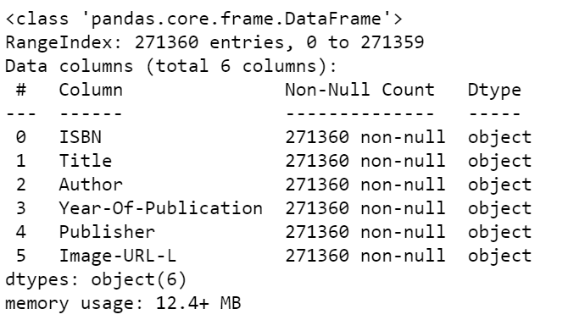
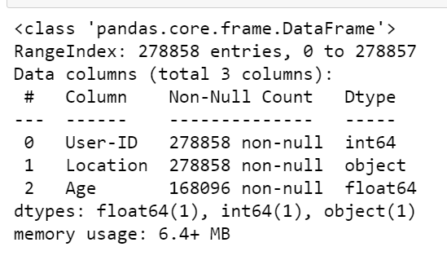
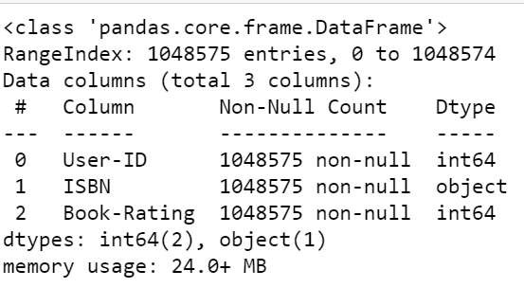
3. Datasets Details
Book Dataset
No. of rows:-271360
No. of columns:-8
Users Dataset
No. of rows:-278858
No. of columns:-3
Rating Dataset
No. of rows:-1149780
No. of columns:-3

Slide 9

4. Data Preprocessing
In Books Dataset
Checking of null values and missing data.
Removal of two columns of small image URL and large image URL.
Changing column names for easy recognition.
In the publisher column missing value with others.
In the Year Of Publication column we have two object data DK Publishing Inc replaced this with 2000 and Gallimard replace it with 2003.
In Users Dataset
In the Users dataset in the Age column we find unique values and with that, we calculate the mean age.
In the Location columns, we have combined information about the city, state, and country we split this information into three different columns.
In Rating Dataset
In this data set we check Book-rating and User-Id are columns that are numerical
type.
In the ISBN column we
remove extra characters.

Slide 10
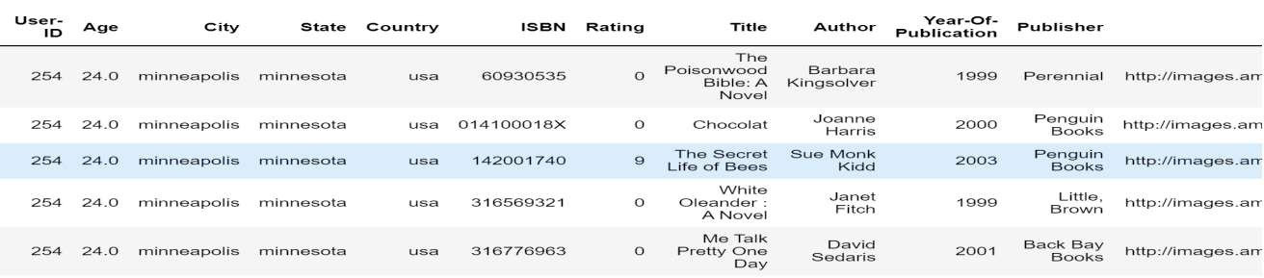
Final Dataset Details
After applying preprocessing on all three datasets. We merge all and made the final data set for visualization and model building.
Datasets
Rows And
Columns
No. Of Unique
User-ID
Null Values
Data Types
Final Dataset
After merging of all three preprocessed datasets
50815 Rows
8 Columns
95513
Total null values of all 3 datasets are6
Int(32) 1 columns
Object 8
columns

Slide 11

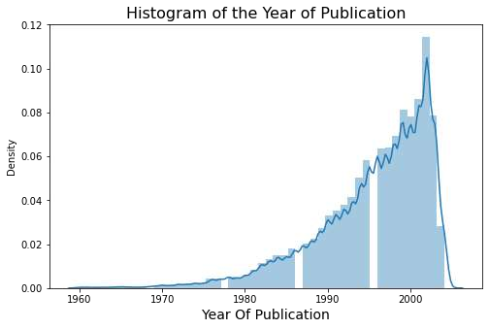
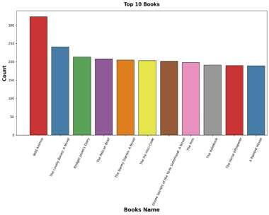
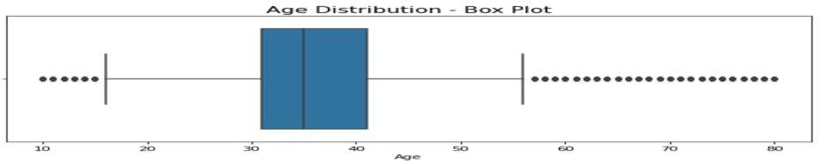
5. Visualization
In Histogram represents
the Year Of Publication
Graphical representation of top
10 books
From 1990 to 2005 we saw there are many publishers.
Outliers
There are many outliers in age columns
Outliers are treated with mean values.

Slide 12
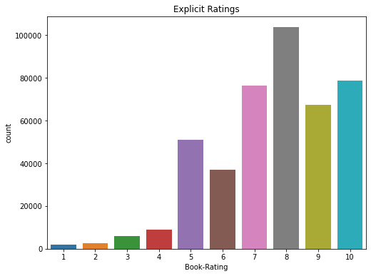
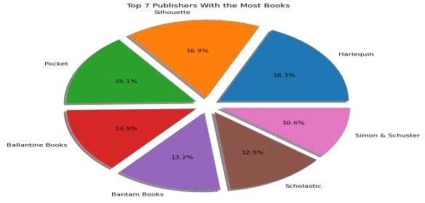
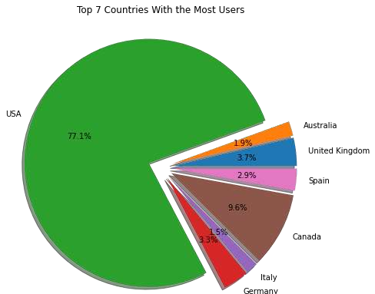
Top 7 Publishers With the Most Books
Divide the complete dataset based on implicit and explicit ratings.
In the Explicit dataset we get a rating above zero
In the Implicit dataset we get a rating of zero.
So, we select the Explicit dataset.
In Explicit rating we find that more people rated above 6 and most of the people rated 8.
Top 7 Countries With the Most
Users

Slide 13
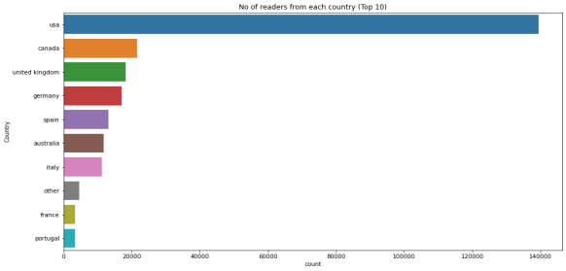
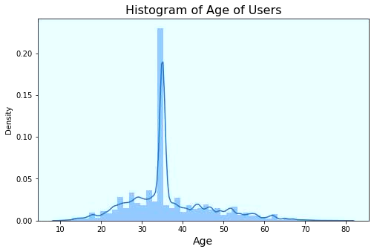
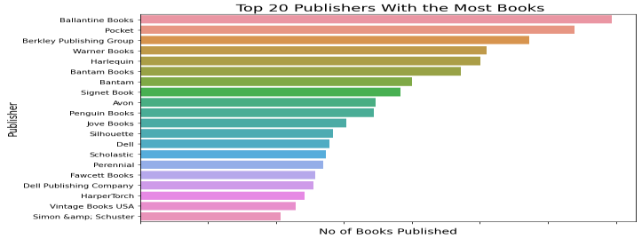
Below Histogram Represents the age of users.
Aged between 30 to 40 most users read books.
Top 15 Highest Reader From Countries
Top 20 Publisher With The Most Book

Slide 14
6. Recommendation Techniques
6.1 Popularity-Based Recommendation System :-
It is a type of recommendation system which works on the principle of popularity and or anything which is in trend. These systems check the product, movies, or books that are in trend or are most popular among the users and directly recommend those.
Advantage of popularity-based recommendation system
There is no need for the user’s historical data.
Disadvantage popularity-based recommendation system
The system would recommend the same sort of products/books which are solely based on popularity to every other user.

Slide 15
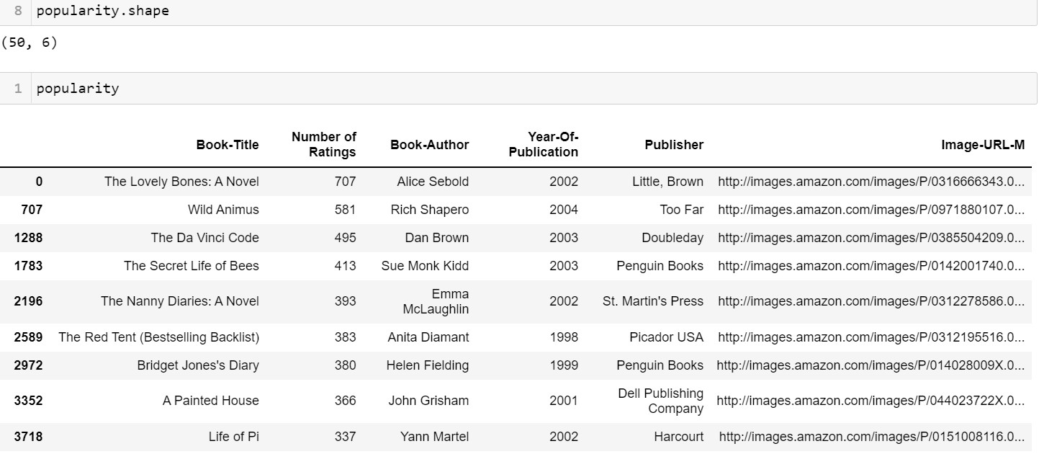
Popularity-Based Recommendation System Dataframe

Slide 16
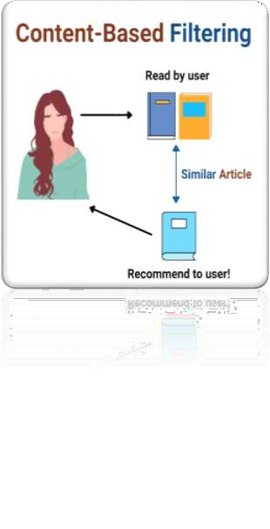
6.2 Content-Based Filtering:-
A content-based recommender works with data that the user provides, either explicitly (rating) or implicitly (clicking on a link). Based on that data, a user profile is generated, which is then used to make suggestions to the user.
Advantage of content-based recommendation system
Able to recommend users with unique tastes.
Can explain the recommendation.
Disadvantage of content-based recommendation system
Data should be in a structured format.
Unable to use quality judgments from other users.

Slide 17
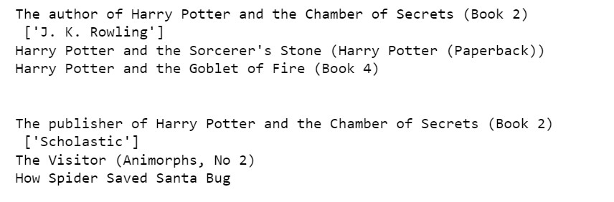
Content-Base Filtering Result

Slide 18
6.3 Collaborative Filtering:-
Collaborative filtering is used by most recommendation systems to find similar patterns or information of the users, this technique can filter out items that users like on the basis of the ratings or reactions by similar users.
Advantages of collaborative filtering
Other user scores are used.
No deterministic result since chance is involved in the system.
Disadvantages of collaborative filtering
Needs more data.
Problems with new users and new products.

Slide 19
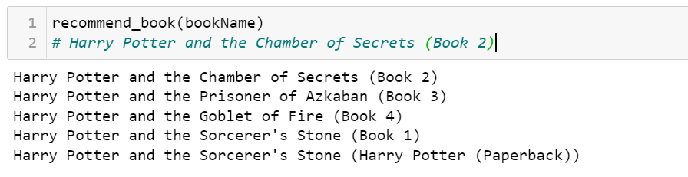
Result Of Collaborative Filtering

Slide 20

CHALLENGES IN PROJECT
In Start, we face difficulty with the dataset we have three datasets in that multiple columns are interlinked
with each other. In that pre-processed data and finds the relationship between variables.
EDA is an interesting part but the selection of variables and making more effective visualization is quite a tough task
A most difficult task for the team to build an accurate model, we made 5-6 models and selected only three that show accurate recommendations.
In deployment, we learned streamlit and HTML for making a good interface. It takes time and continuous
discussion in the team and we did make a great app page.

Slide 21
References

Slide 22
THANK YOU

